Slide 1
Why Blue Team is Best Team

Slide 2






- One metric Aaron
/
hotpheex

Slide 3

Very Forced Audience Participation
“I am working towards entering the Information Security industry”
“I want to work as a Penetration Tester”
“I am Skeletor”

Slide 4

What is a Blue Team?
Blue teams:
Solve Problems
Ensure effective security measures
Continuously improve them
Respond to incidents.
Can be run internally, or outsourced to a third party.
Countless different roles.

Slide 5


What is a Red Team?
Red teams:
Identify Problems
Assume an adversarial role
Evaluate security measures
Identify valid vulnerabilities
Red team == Penetration test

Slide 6
Everybody needs a Blue team
(legal)
Red teams only exist because it helps the Blue teams.
Red Teams identify vulnerabilities in, and recommend solutions for our:
Applications / services
Systems
Processes
Staff

Slide 7
Everybody needs a Blue team
(legal)
Red teams only exist because it helps the Blue teams.
Blue teams make it happen:
Identify potential solutions
Assess technical & business feasibility of solutions
“Sell it” to the rest of the business if necessary
Create more work for already busy people
Continuously support other stakeholders throughout implementation/change

Slide 8

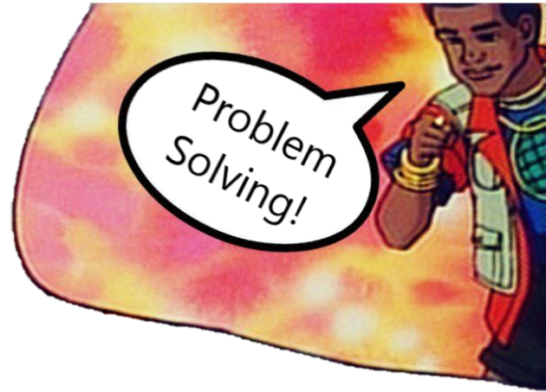



What does it take?

Slide 9



Why should you join the Blue team?

Slide 10
Essential conclusion
Far too many students want to be penetration testers
We need way more blue teamers
Interesting, exciting, rewarding
Endless variety of jobs, everywhere

Slide 11
Make your own choices, but make educated ones.
Work lifestyle > Job title.
The best blue teamers were red teamers, the best red teamers were blue teamers
Think for yourself…
hotpheex

Slide 12




The Security Industry
BONUS SLIDE THAT WAS CUT DUE TO TIME ☹
Vendors
Consulting Firms
End users
Sell products
/services
Boutique
Big 4
Consume products
/services
Support customers
System Integrators
Self protection

